Slide 1
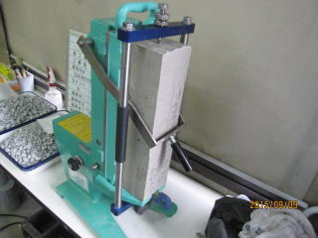
Investigating the Effect of Alkali Silica Reaction in concrete made with Recycle Concrete Aggregate Improved by Carbonation Technology
ASR is one of the deleterious problem of the concrete made with Recycled aggregate. Carbonation mechanism was used to reduce the rate of ASR of Recycled Aggregate Concrete.
L = low RCA
LC= carbonated RCA
H = High RCA

