Slide 1

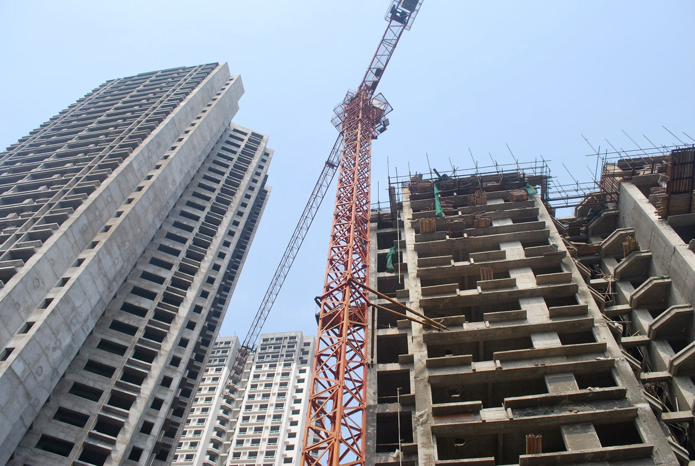


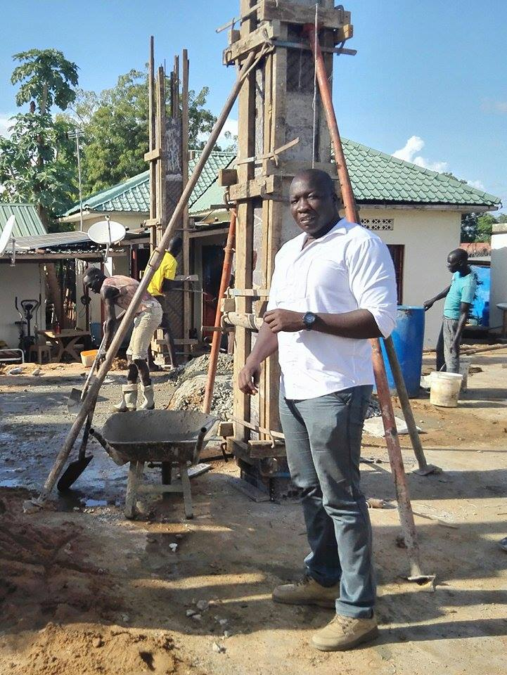
The effect of Water-Cement (W/C) ratio on permeability and strength of concrete
Research Aims Designing of High strength Concrete to enable taller, durable and cost effective Concrete Structures Concrete with high performance in Different geographical locations. Methodology Supplementary Cementitious Material (SCM) e.g.. Chemical and Mineral admixtures such as fly ash, silica fume, granulated blast furnace slag (ggbfs). check their reaction, microstructures, strength- porosity reaction.
1. Characteristic and Mix design proportions
2. Curing condition
3. Experiment Test
TARGET
RESULTS 2018
EXPERIMENTS
INTRODUCTION
THANK YOU
PREPARED BY: ME17109 CHACHA

