Slide 1
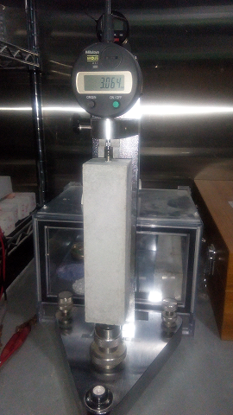
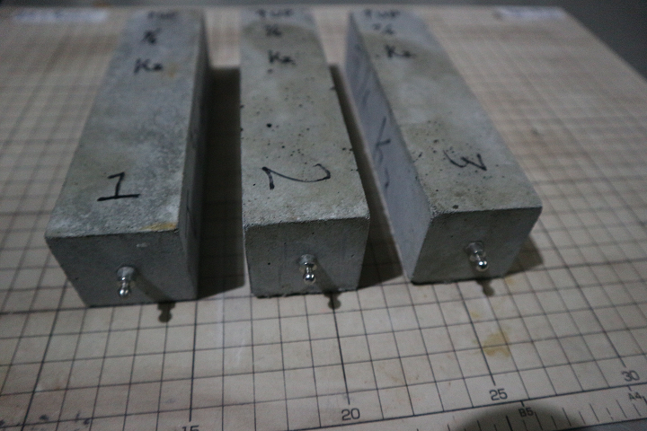
Investigating the Effect of Alkali Silica Reaction in concrete made with Recycle Concrete Aggregate by Carbonation
A potential solution for both sustainability in demolition and increased service life is repurposing concrete that is taken out of service as recycled concrete aggregate (RCA); This material allows for a more economical aggregate source for towns that are located far from any virgin aggregate sources. Recycling existing concrete for use as aggregate in new construction has gained consideration in recent years because of high costs of disposal of waste concrete and shortage of virgin aggregate. However, the main worry with using RCA as a sustainable construction material is its potential for Alkali-Silica Reaction(ASR), shrinkage, freezing-thawing. The objective of this research is to investigate the effect of ASR on recycled Aggregate improved by carbonation technology.

